Slide 1
NBI- August 19
Create a picture that shows the following about matter.
1. The FOUR states of matter
2. Particle Arrangement: use small circles
3. Tell if each state has a definite shape and volume
4. Give examples of the FOUR states of matter.

Slide 2
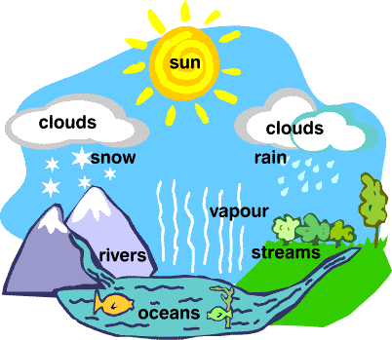
NBI- August 19
Create an anchor chart that illustrates the states of matter and their changes through the example of Olaf or the Water Cycle.

Slide 3
Closure and Homework
Student Essay: Use your knowledge of the Water Cycle to address Olaf’s misconceptions of the state of matter.

Slide 4
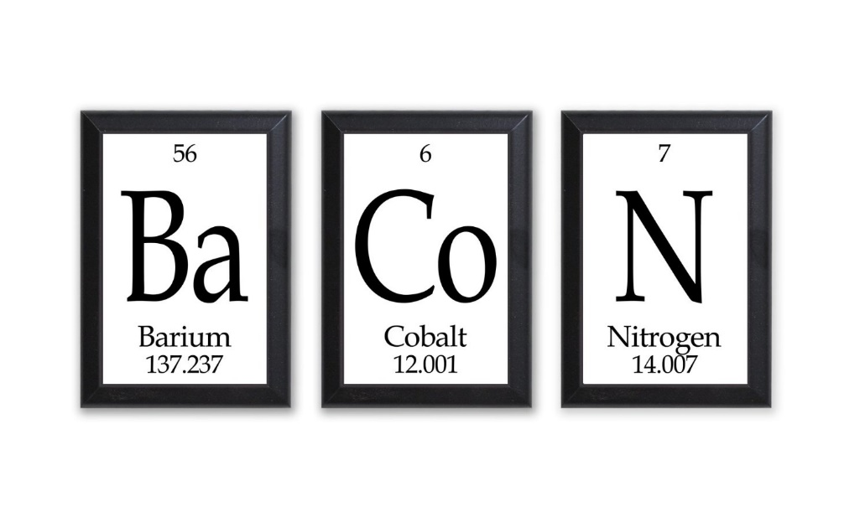
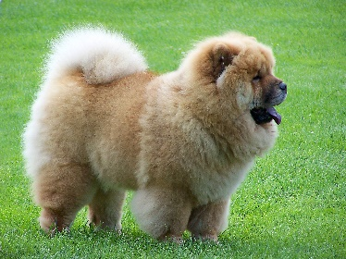
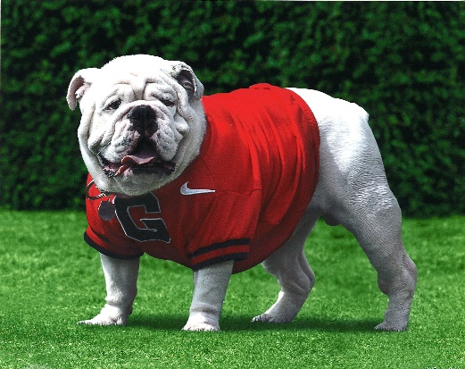





ALL ABOUT ME
7

Slide 5
August 17th 2015
page3
DO: I will be able to explain the scientific view of the nature of matter by illustrating the movements of particles in solids, liquids, gases, and plasma states.
EQ:
~What is Olaf’s misconception about temperature effects particle arrangement in the states of matter?
~What are the states of matter?
~How does temperature impact the state of matter?
~Why is the molecular structure of matter different?

Slide 6
August 17th 2015
What do you know:
Can you fill in the table?
Matter | Draw space between particles | Draw the movement of particles
SOLID
LIQUID
GAS

Slide 7
My Thoughts
page2
What are Olaf’s misconceptions about the states of matter and heat?

Slide 8


Slide 9
Phases of Matter

Slide 10
Self-Check
 | YES | NO
1. I can describe how atoms move in a solid, liquid, and gas
2. I can describe the speed/energy of the atoms in a solid, liquid, and gas.
3. I can explain how the distance between atoms is related to the states of matter.
4. I can indicate whether or not each state of matter has a definite shape and volume
5. I can explain how the volume of a gas is changed by a change in pressure.
6. I can explain how the volume of a gas is changed by a change in temperature.
Notes:
Use this slide as a pre-test or pre-quiz to see what students already know. I like to have my students record their answers privately, then put them away. At the end of the lesson or unit the students take the quiz again and compare their post-unit answers to their pre-quiz answers.
These “I Can” statements also give students a very clear visualization of what you expect them to know for the test.

Slide 11
Phases of Matter
Solids: Particles are tightly packed together and DO NOT move past each other. They vibrate in place.
Notes:
The animation on this slide is meant to show students that the atoms in a SOLID object are moving, but cannot move past one another.

Slide 12
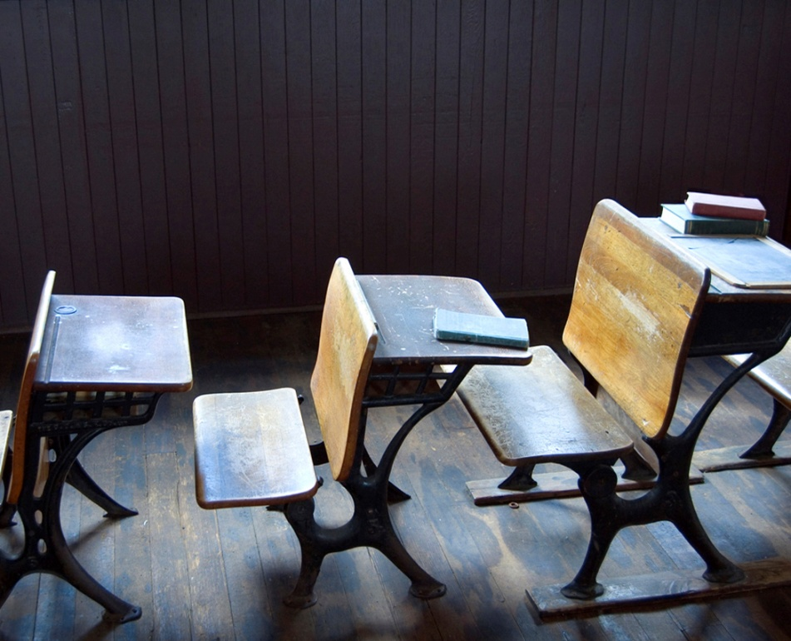
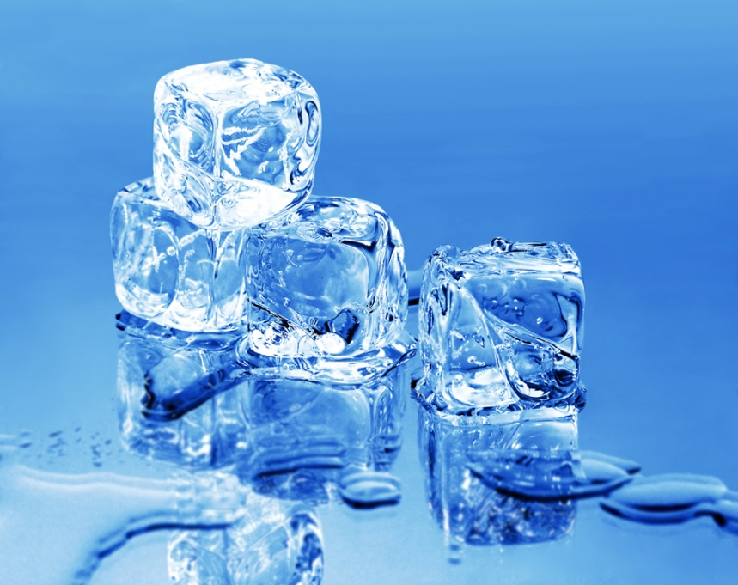

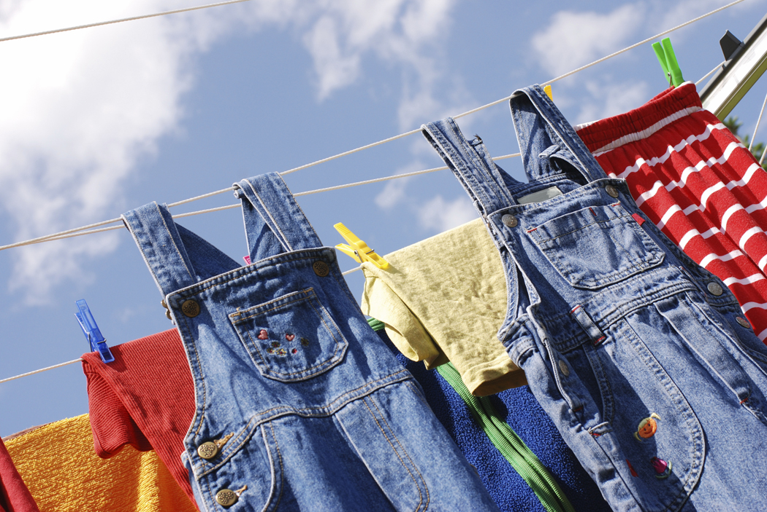
Phases of Matter
Examples of Solids:
Notes:
Just a few examples of “Solids” the students may have used in the last 24 hours: ice, bicycle, school desk, road sign, school bus, clothing

Slide 13
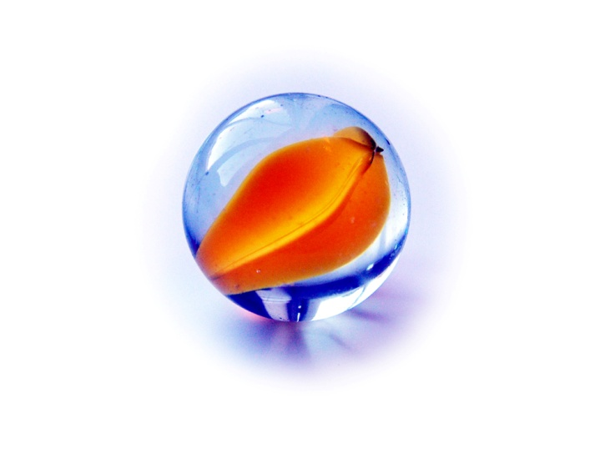
Phases of Matter
Solids have a definite SHAPE
Solids have a definite VOLUME
Example—Marble
Shape = Sphere
Volume = can be found using water displacement

Slide 14
Phases of Matter
Liquids: Particles are still tightly packed together and they SLIDE move past each other.
Notes:
The animation on this slide is meant to show students that the atoms in a liquid are relatively close together, but slide past one another.

Slide 15


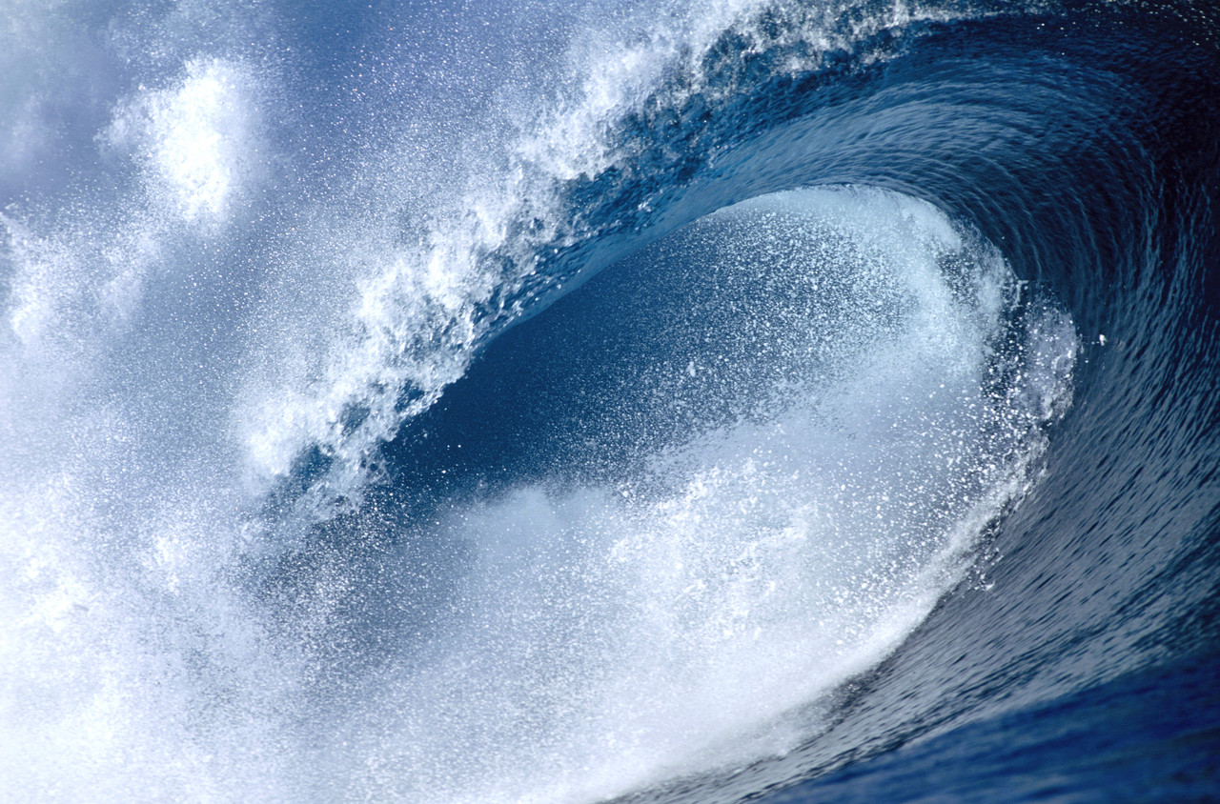
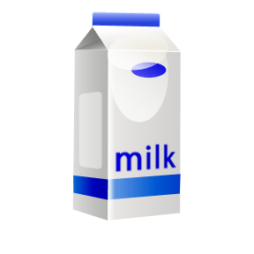
Phases of Matter
Examples of Liquids:
Notes:
Examples of liquids: milk, ocean, gasoline, melted chocolate, soda, lemonade

Slide 16
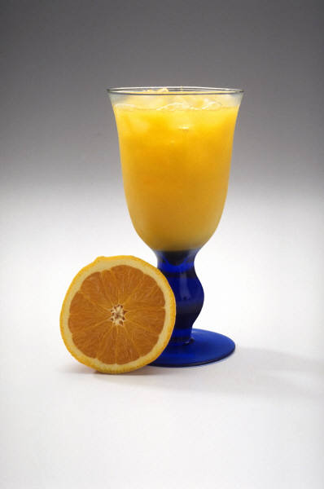
Phases of Matter
Liquids DO NOT have a definite SHAPE, they take the shape of their container.
Liquids have a definite VOLUME
Example—Orange Juice
Shape = None, it takes the shape of the glass.
Volume = can be found using a beaker or graduated cylinder.

Slide 17
Phases of Matter
Gases: Particles are not tightly packed together, and have so much energy they slip past each other quickly.
Notes:
The animation on this slide is meant to show students that the atoms in a GAS move quickly and can spread a further distance than the atoms in solids and liquids.

Slide 18

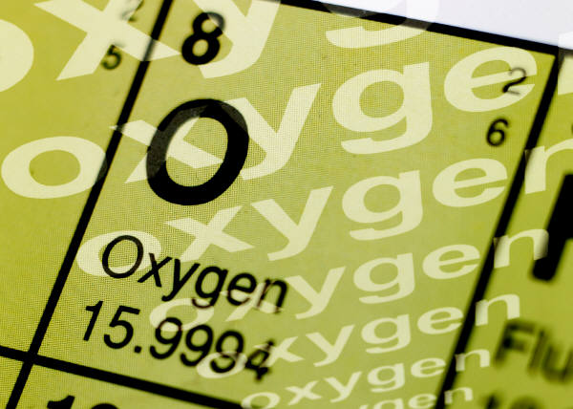
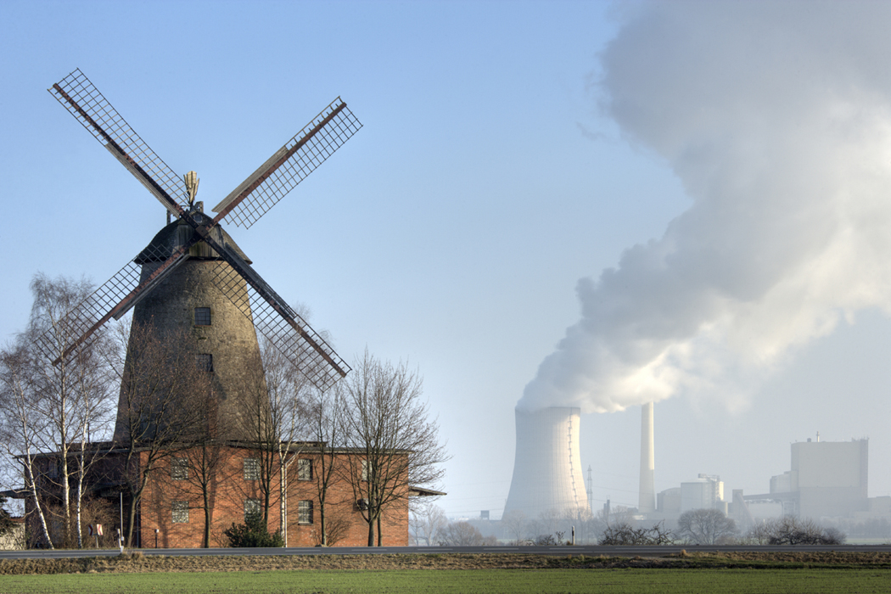

Phases of Matter
Examples of Gases:
Notes:
Examples of gases: Helium, Atmosphere/Water Vapor, smoke, “pollution”, oxygen

Slide 19
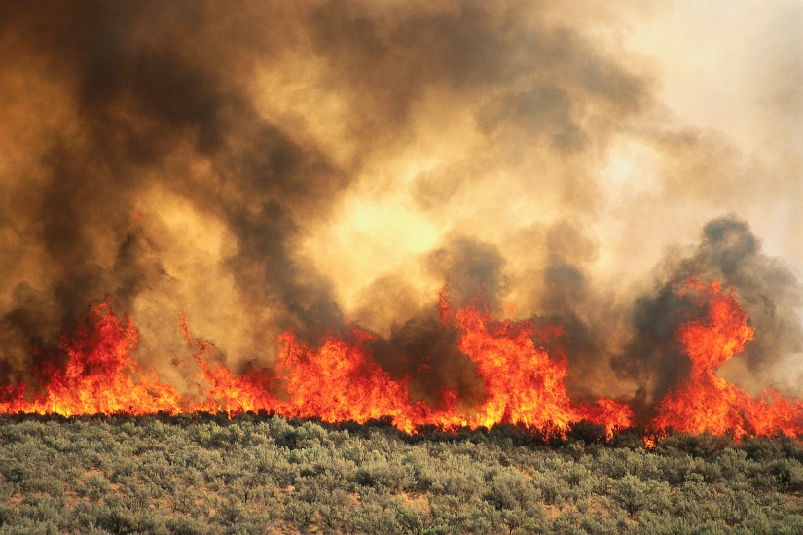
Phases of Matter
Gases DO NOT have a definite SHAPE
Gases DO NOT have a definite VOLUME
Example—Smoke
Shape = Not definite.
Volume = Not definite. Gases are usually always expanding.

Slide 20
August 18th 2015
page5
DO: I will be able to explain the scientific view of the nature of matter by illustrating the movements of particles in solids, liquids, gases, and plasma states.(the same as 8-17)
EQ:
~What is Olaf’s misconception about temperature effects particle arrangement in the states of matter?
Why is the molecular structure of matter different?
How do the particles of cold water differ to those in hot water?
How would a gas be described by its shape and volume?

Slide 21
Think on it…
1. A piece of solid wax is place in a pan and heated on a stove. After a while, the solid becomes a liquid. This occurs because of…
a. Some of the wax molecules get smaller
b. Some of the wax molecules get destroyed
c. The wax molecules change into water molecules
d. The wax molecules are more loosely connected.

Slide 22




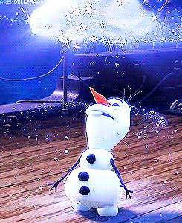
Agenda
Olaf~ Write a quick explanation of the phases of matter using Olaf’s in Summer as an example or draw a comic strip.

Slide 23
Phases of Matter
Plasma: Particles are moving so quickly it is hard to see what they are actually doing.
Notes:
This animation is meant to show students that PLASMA is the phase of matter that is the fastest moving and it is impossible to see exactly how the atoms are moving.

Slide 24
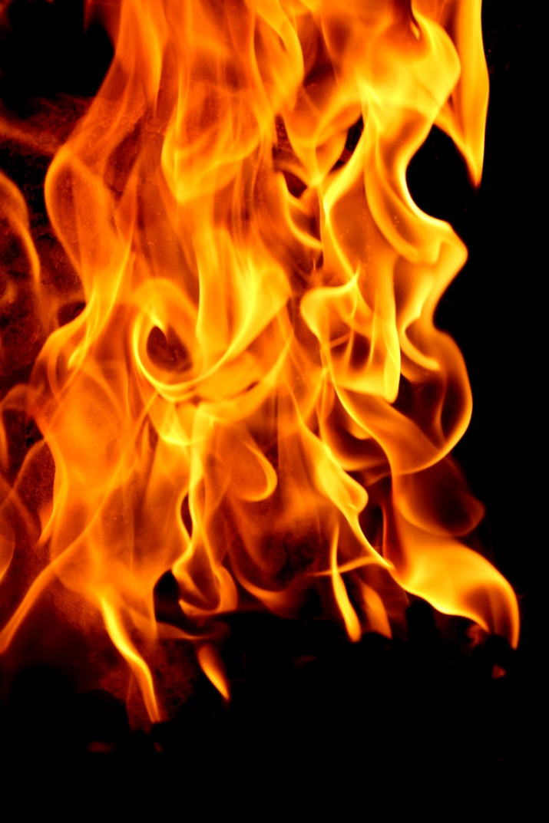

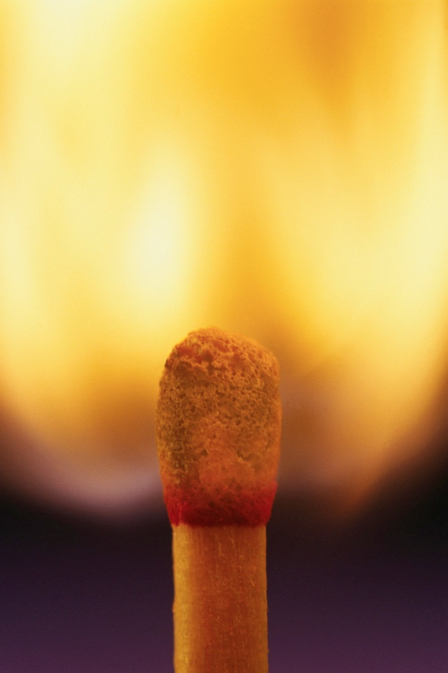
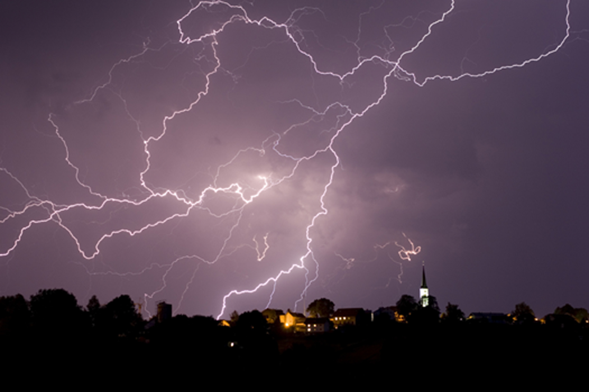
Phases of Matter
Examples of Plasma on Earth:
Notes:
Plasma on Earth: lightning, fire

Slide 25
Phases of Matter
T
=
V
Two “laws” about gases…
Charles’ Law
Volume (of gas) and Temperature
When temperature goes up, volume goes up
When temperature goes down, volume goes down

Slide 26
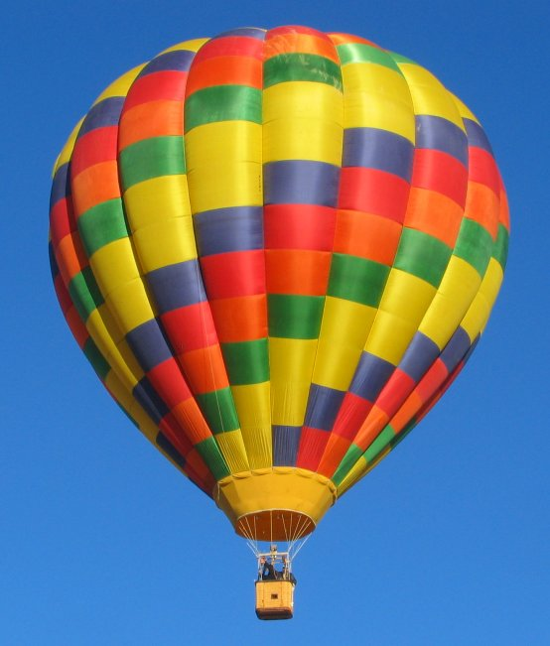
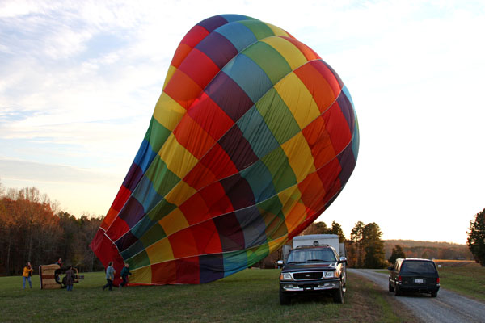
Gas + Heat
= Expansion!
http://www.usaballoon.com/fly.htm
http://www.coloradoguy.com/balloona-vista/hotairballoons-buenavista-co.htm
Notes:
These pictures and illustrations are meant to show students that the molecules inside a hot air balloon are closer together when the balloon is deflated, and farther apart when the balloon is inflated.

Slide 27
Phases of Matter
V
=
P
Two “laws” about gases…
2. Boyles’ Law
Volume (of gas) and Pressure
When pressure goes up, volume goes down
When pressure goes down, volume goes up

Slide 28
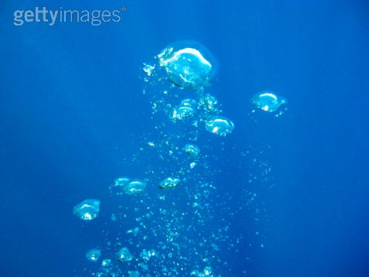

The amount of water pressure determines the size of bubbles in the water.
http://www.gettyimages.com/detail/91300130/Photographers-Choice
http://gallery.photo.net/photo/9734756-lg.jpg
Notes:
These pictures show students that when a scuba diver blows bubbles deep in the ocean the bubbles are small, but as the bubbles rise to the surface (as the pressure decreases) they get bigger (their volume increases).

Slide 29
Low pressure
Large Volume
High pressure
Small Volume

Slide 30
Bose-Einstein Condensate
Exist at extremely cold temperatures (around absolute zero or -460 ºF)
Particles are super unexcited
Particles lock or “clump” together so firmly that they move as a single unit
Definite shape and volume (?)

Slide 31
Solid
Particles are tightly compact
Very Dense (thick)
Particles vibrate without the ability to move freely
Definite (exact) shape and volume
Solid Animation

Slide 32
Discussion: Cyclical processes and phase changes.
*make other connections between transitions and cyclical changes as compared to the phase changes observed in matter.

Slide 33
Closure and Homework
Student Essay: Use your knowledge of the Water Cycle to address Olaf’s misconceptions of the state of matter.

Slide 34
August 21st 2015
DO: I will be able to identify and explain the differences in the physical and chemical properties of matter and the chemical and physical changes of matter.
EQ:
What is the difference between physical and chemical change?
What are some of the unique physical and chemical properties of each state of matter?
What are some of the properties of a substance as it undergoes different physical and chemical changes?

Slide 35
Think on it…
1.Characteristics that can only be seen when the material changes and new materials are formed.
a. Chemical properties
b. Physical properties
c. Chemical changes
d. Physical changes

Slide 36
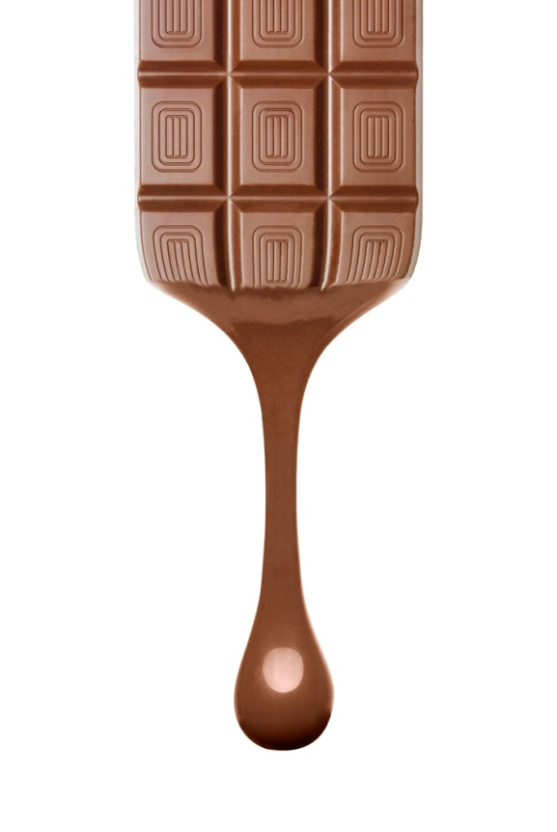
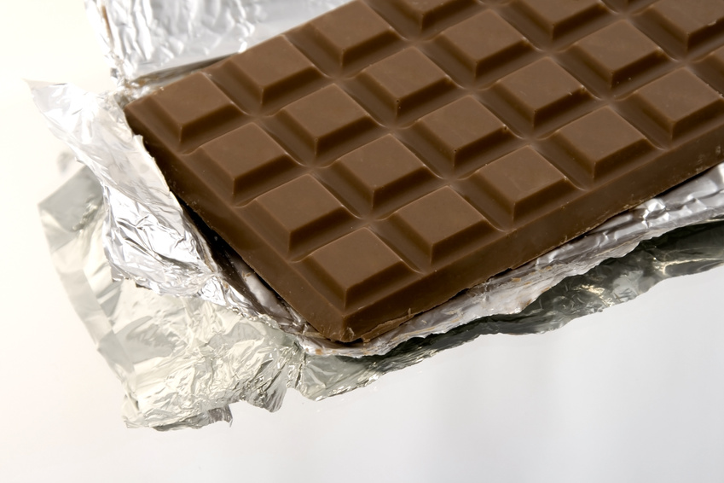
Phases of Matter
ADDED
The added energy has caused the chocolate particles to speed up. Before they were vibrating in place, now they are moving fast enough to slip past one another.
Is ENERGY being ADDED or TAKEN AWAY in this phase change:
Solid
Liquid

Slide 37

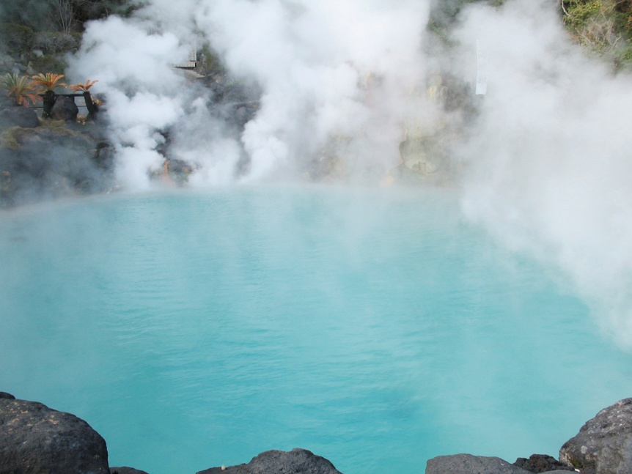
Phases of Matter
Is ENERGY being ADDED or TAKEN AWAY in this phase change:
ADDED
The added energy has caused the water particles to speed up. Before they were moving fast enough to slip past one another, now they have enough energy to break away from one another and expand.
Liquid
Gas

Slide 38
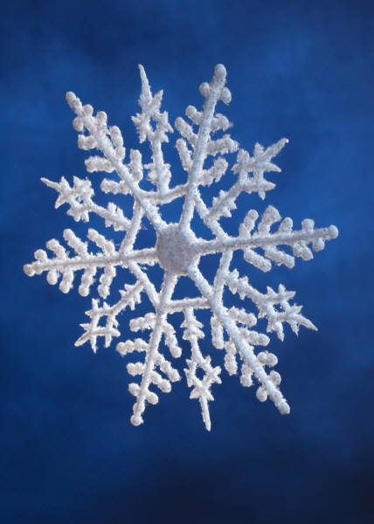

Phases of Matter
Is ENERGY being ADDED or TAKEN AWAY in this phase change:
Taken Away
Taking away energy from a rain drop slows the water molecules down so that they no longer slide past one another.
Liquid
Solid

Slide 39
Matter
Anything that has mass and takes up space (volume)
  Examples:
    A brick(a solid) has mass and takes up space
    A desk has mass and takes up space
    A pencil has mass and takes up space
    Air (a gas) has mass and takes up space
    Gasoline (a liquid) has mass and takes up space
All of the above examples are considered matter because they have mass and take up space. Can you think of anything that would not be considered matter?

Slide 40
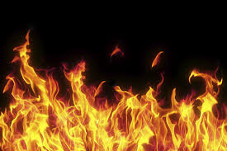
Matter
Yes! Fire is NOT an example of matter

Slide 41
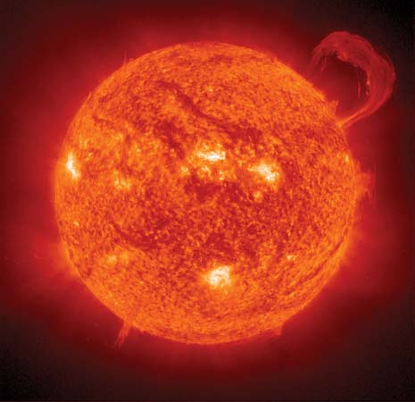
WHY
Fire is NOT an example of matter
When a gas is heated by many thousands of degrees, the individual atoms collide with enough violence to knock electrons free, resulting in a collection of positively charged ions and free, negatively charged electrons. The gas is said to be ionized, and when a sizable number of the atoms become ionized, the gas is called a plasma.
Photograph: The interaction of the Sun's magnetic field with the motions of the plasma in and around the Sun …
The interaction of the Sun's magnetic field with the motions of the plasma in and around the Sun … NASA
Fire while hot does not ionize with enough particles under pressure to be considered a traditional plasma or for that matter… MATTER; it is considered by most scientists to be a chemical reaction.

Slide 42
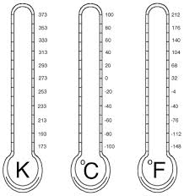
Physical Properties of Matter
Any property of matter that can be observed or measured without changing the identity of the matter
Examples
temperature
color
shape
taste
state/phase
density
D = m
V

Slide 43


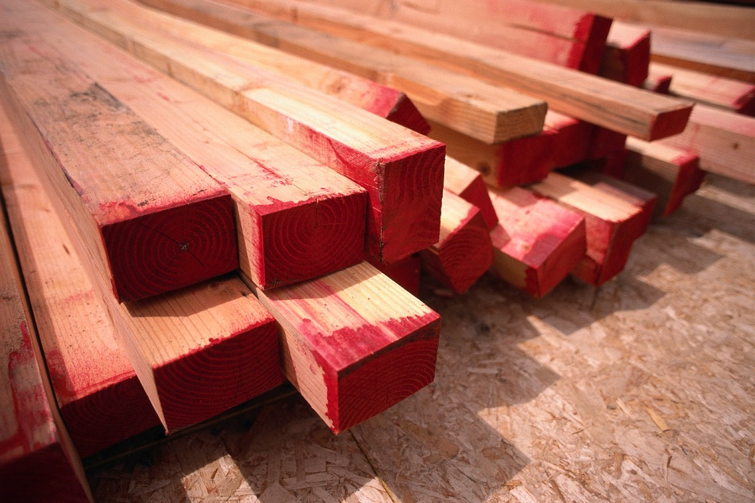

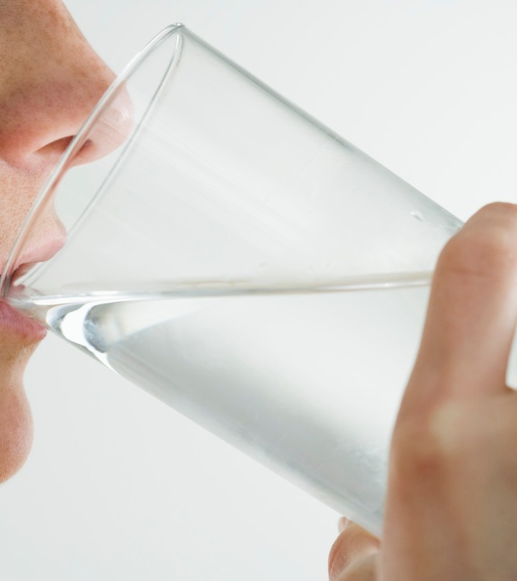
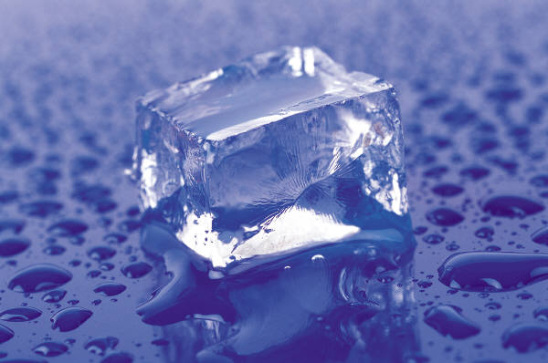
Phases of Matter
Physical Changes: only the phase changes, the substance does not.
Physical changes usually change the size or shape of the substance.
Examples of physical changes include:
Notes:
Examples of physical changes: water to ice, paper to confetti, wood to pencil

Slide 44


Chemical Properties of Matter
any property of matter that describes a substance based on its ability to change into a new substance
Examples
flammability
reactivity with vinegar
reactivity with oxygen
Iron + Oxygen → Iron oxide (rust)
2Fe + 3O₂ → Fe₂O₃

Slide 45
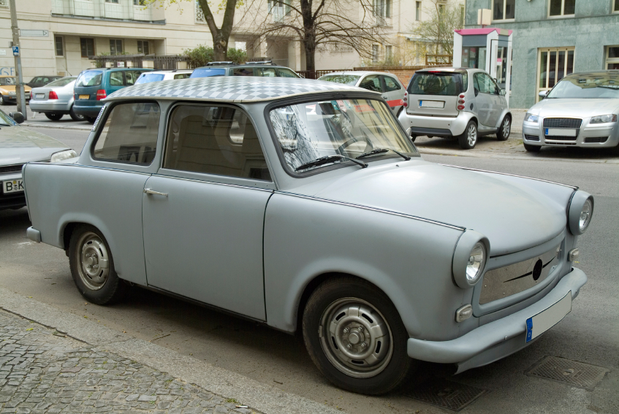
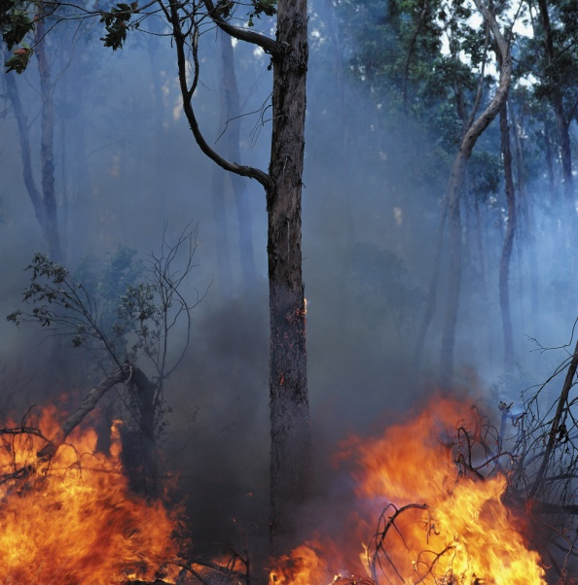

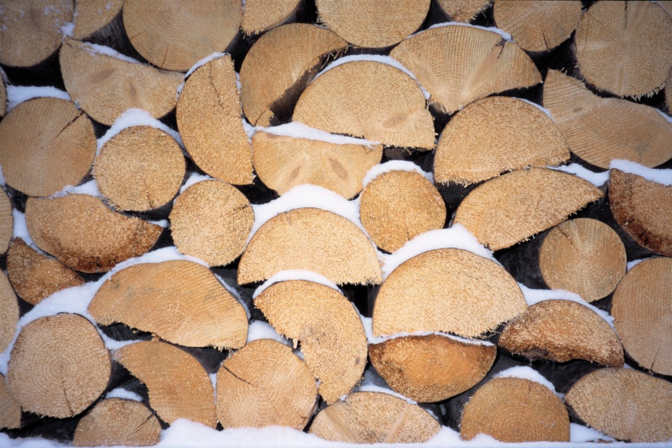
Phases of Matter
Chemical Changes: changes that create NEW materials.
The original materials are changed into something different.
Examples of chemical changes include:
Notes:
Examples of chemical changes: wood to ash, metal to rust

Slide 46
Chemical or Physical Property?
Paper is white
Boiling point of H₂O is 100ºC
Zinc reacts with hydrochloric acid and creates hydrogen gas
Nitrogen does not burn
Sulfur smells like rotten eggs
_____________ Property
_________________ Property
__________________ Property
__________________ Property
__________________ Property

Slide 47
Comparing Physical and Chemical Properties
Substance/Matter | Physical Property | Chemical Property
Helium | Less dense than air | Nonflammable
Wood | Grainy texture | Flammable
Baking soda | White powder | Reacts with vinegar to produce bubbles
Powdered sugar | White powder | Does not react with vinegar
Rubbing alcohol | Clear liquid | Flammable
Red food coloring | Red color | Reacts with bleach and loses color
Iron | Malleable | Reacts with oxygen

Slide 48
Physical Properties of Matter
Any property of matter that can be observed or measured without changing the identity of the matter
Examples
temperature
color
shape
taste
state/phase
density
D = m
V

Slide 49
Density
a measure of the amount of matter present in a given volume of a substance
typically expressed in the following units:
  grams per cubic centimeter (g/cm³) for solids
  grams per milliliter (g/ml) for liquids
can change as temperature and pressure change
does not depend on how much of a substance you have (intrinsic property) – in other words, the density of a gold bar would be the same as the density of a gold flake
m
.
D
V
Which do you think
is more dense? Why?

Slide 50

Changes in States
(Physical Changes)
Why do you think Bose-Einstein and plasma are not equally distanced from the other three states of matter?
Ionization
Plasma
Disposition
Recombination
Vaporization
(Evaporation/Boiling)
Gas
Melting
Liquid
Condensation
Solid
Freezing
Sublimation
Bose-Einstein
All changes in state require a change in energy

Slide 51
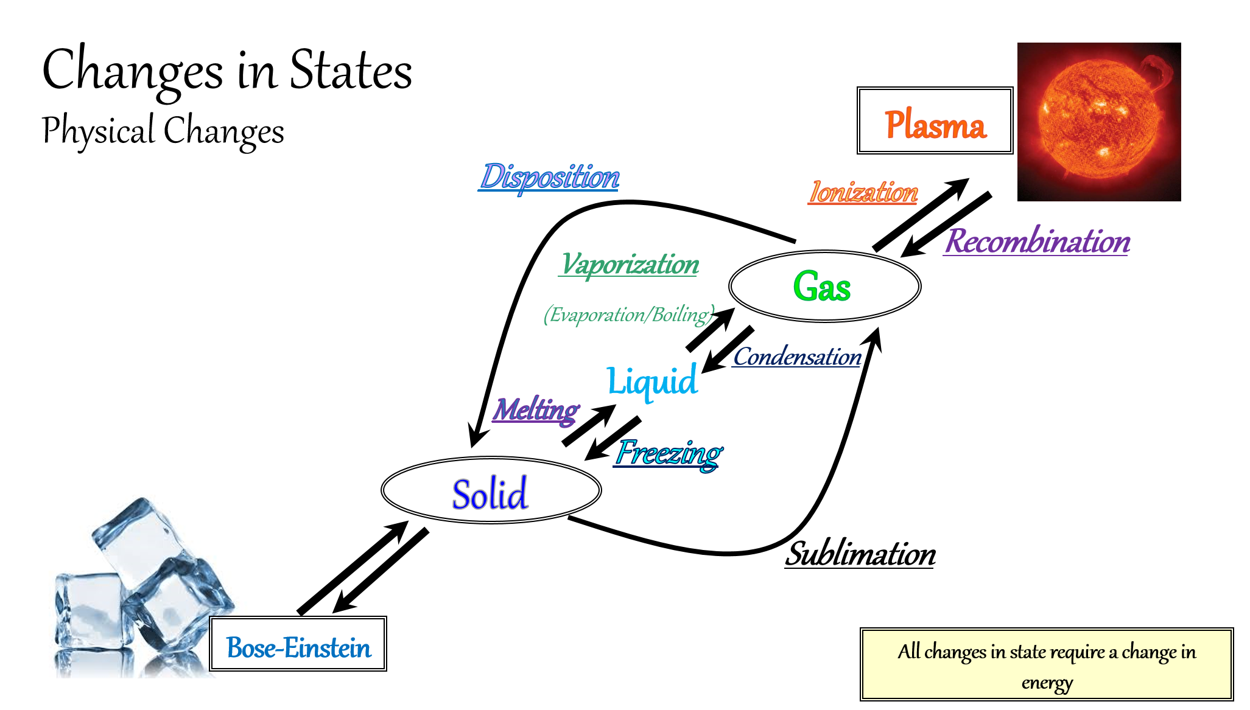

Slide 52
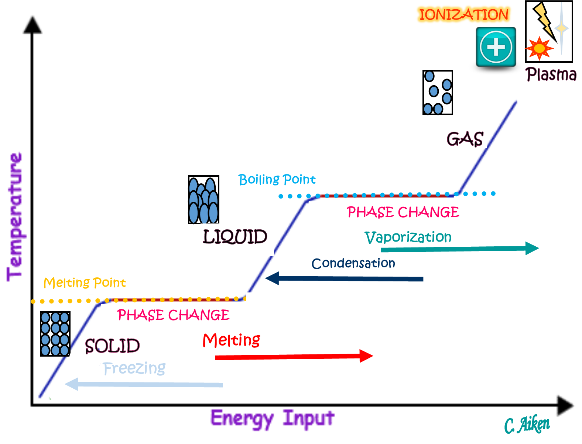

Slide 53
Chemical or Physical Change?
Bending a Paper Clip
Baking a cake
The sublimation of carbon dioxide
Crushing an aluminum can
Vinegar and baking soda combining to create salt and water
Physical Change
Chemical Change
Physical Change
Physical Change
Chemical Change

Slide 54
EXOTHERMIC | ENDOTHERMIC
Exothermic- the word describes a process that releases energy in the form of heat. Forming a chemical bond releases energy and therefore is an exothermic process. Exothermic reactions usually feel hot because it is giving heat to you. | Endothermic - a process or reaction that absorbs energy in the form of heat. Breaking a chemical bond requires energy and therefore is Endothermic. Endothermic reactions usually feel cold because it is taking heat away from you.

Slide 55
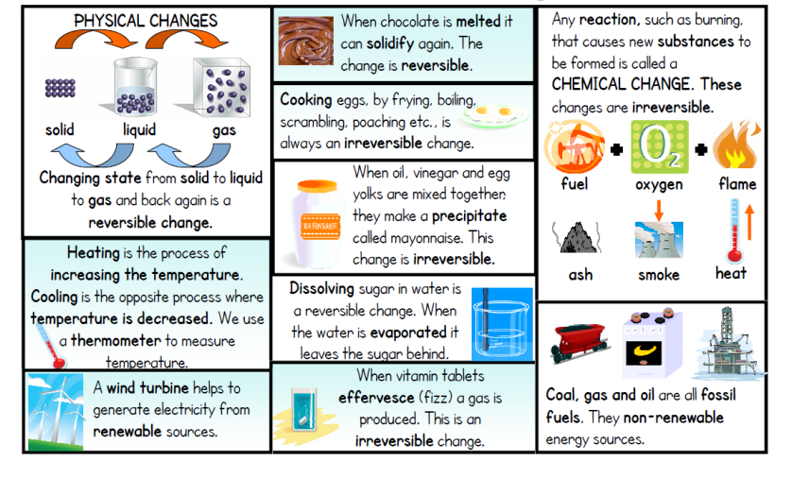

Slide 56
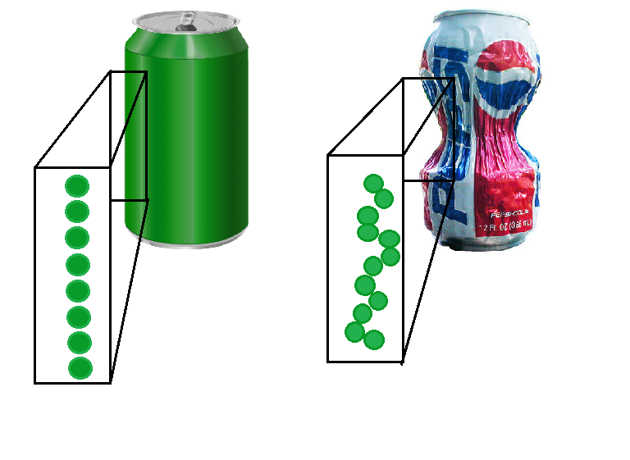
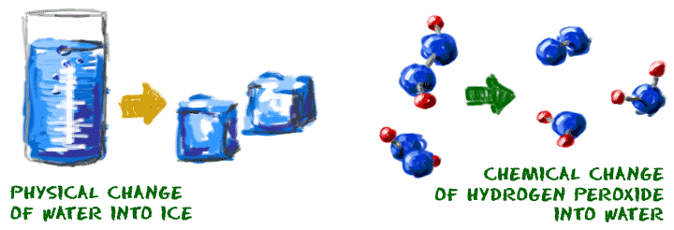
Law of Conservation of Matter
Matter cannot be created or destroyed. Either it is changed physically or chemical changes allow for atoms to break and establish new bonds creating different substances with the same molecules.

Slide 57



Mass vs. Weight
Mass
a measure of how much matter an object is made of
does not change, regardless of where something or someone is
Weight
the force of gravity on an object
equal to the mass of the body times the local acceleration of gravity
Why do you think the person’s weight is less on the moon?
Mass = 59 kg
Mass = 59 kg
Weight = 579 N
Weight = 96 N
http://www.exploratorium.edu/ronh/weight/index.html

Slide 58

REVIEW

Slide 59
5 Physical States of Matter
Bose-Einstein
Solid
Liquid
Gas
Plasma

Slide 60
Phases of Matter
Matter can change phases permanently or temporarily.
Temporary changes are called PHYSICAL changes.
Permanent changes are called CHEMICAL changes.

Slide 61


Phases of Matter
Is this a chemical change, or a physical change?
Chemical
The bottle rocket is being turned into a new substance.

Slide 62
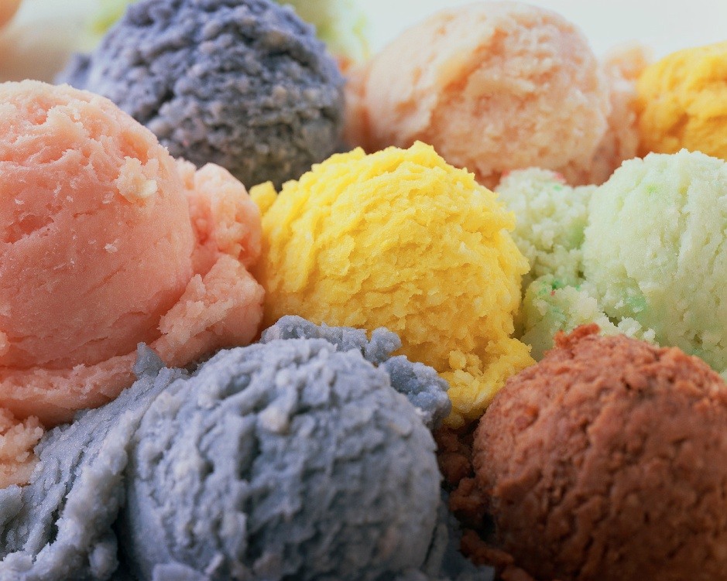
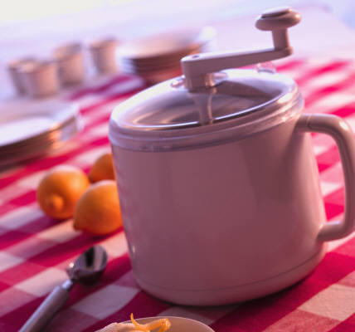
Phases of Matter
Is this a chemical change, or a physical change?
Physical
The ingredients for ice cream are mixed and cooled in a machine. The ice cream has the same chemical structure when it was a liquid as it does when it is a solid.
Notes:
Mixing and cooling ice cream is a physical change

Slide 63
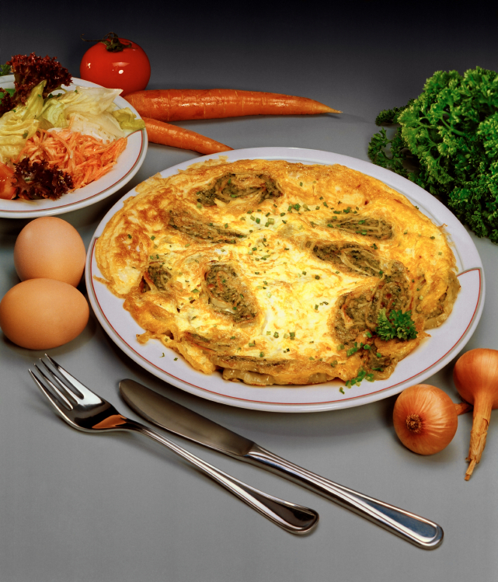
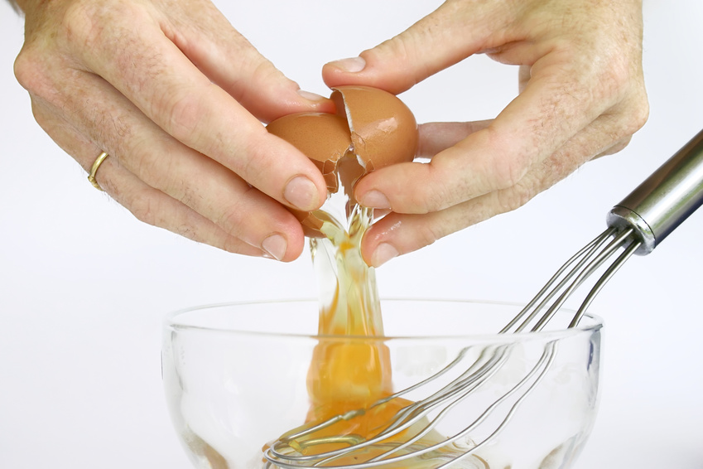
Phases of Matter
Is this a chemical change, or a physical change?
Chemical
The egg has been cooked, and that has changed it into a new substance.

Slide 64
Phases of Matter
Let’s summarize:
Phase | Motion of Particles | Speed of Particles
Solid | Particles vibrate in place | Slow
Liquid | Particles are close, but can slide past one another | Medium
Gas | Particles are constantly expanding | Fast
Plasma | Unknown | Faster than we can see

Slide 65
Phases of Matter
Let’s summarize:
Phase | Definite Shape? | Definite Volume?
Solid
Liquid
Gas
Plasma
YES
YES
NO
YES
NO
NO

Slide 66
Self-Check
 | YES | NO
1. I can describe how atoms move in a solid, liquid, and gas
2. I can describe the speed/energy of the atoms in a solid, liquid, and gas.
3. I can explain how the distance between atoms is related to the states of matter.
4. I can indicate whether or not each state of matter has a definite shape and volume
5. I can explain how the volume of a gas is changed by a change in pressure.
6. I can explain how the volume of a gas is changed by a change in temperature.
Notes:
Now that the students have been taught these key points, you can have them do another self-check. Students who still say “NO” to 5 or more “I Can” statements should be given remedial help.

